Slide 1
Data mining for Business Analytics
Data Exploration and Data Preprocessing
Based on Titanic Dataset
ISOM3360
Lab 1

Slide 2
The Titanic Case – Prediction on Survival
Reasons for passengers who survived
Women, Children
Upper-class / Social Status
Luckiness
…
In this very first project, we are trying to analyze what kind of people were likely to be survived
You can refer to the following link to know more about the project https://www.kaggle.com/c/titanic

Slide 3
Data Exploration
Before we start our analysis, it is always a good practice to look into our data first
Import related libraries for data management and then load the datasets
# import library used for data management
import numpy as np
import pandas as pd
# load datasets
train = pd.read_csv('train.csv’, index_col='PassengerId')
test = pd.read_csv('test.csv’, index_col='PassengerId')

Slide 4
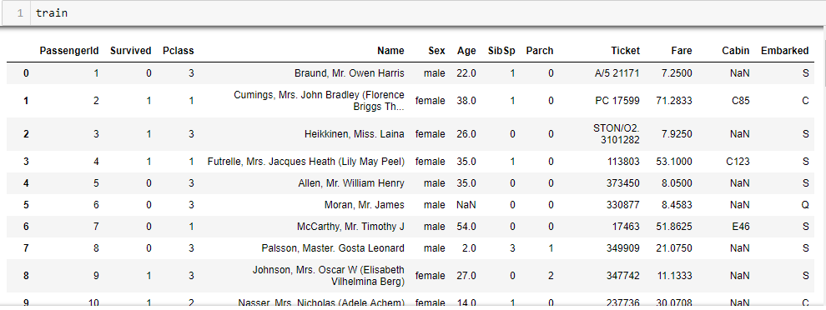
View the datasets
Simply typing in the name of the data frame will result in nicely formatted outputs
Use .head() to view the first 5 instances

Slide 5
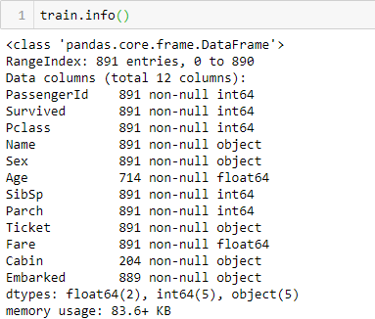
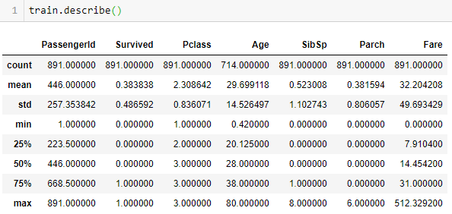
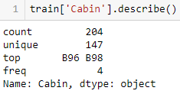
View Dataset information / description
Use .info() and .describe() to get an overview of the dataset
Is there any problem with this dataset?
Data type?
Missing values?

Slide 6

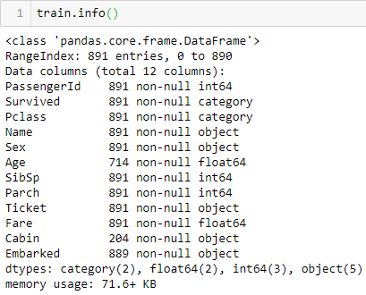
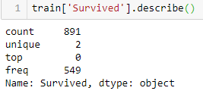
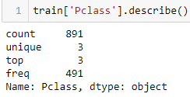
Change data type
You probably have found out that the data type for some variables are not truly represent their meanings
Survived (0 means not survived, 1 means survived)
Pclass (1 = 1st, 2 = 2nd, 3 = 3rd)
Use .astype() to change the data type for a variable
There are missing values for ‘Age’, ‘Cabin’ and ‘Embarked’

Slide 7
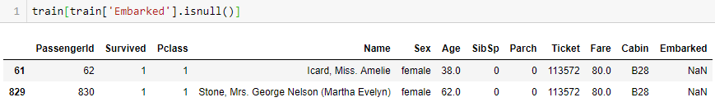
Handle missing values
You can use .isnull() to find out the instances that have missing values
Replace missing values in ‘Age’ with mean (numeric variables)
You can check the data frame info to see whether the missing value in ‘Age’ have been filled up with mean
train['Age'].fillna(train['Age'].mean(),inplace=True)

Slide 8
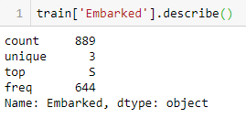
Handle missing values
Replace missing values in ‘Embarked’ with the most frequent value (mode)
Use .describe() to find out the most frequent value for ‘Embarked’
Fill missing values for ‘Embarked’ with ‘S’
Or use the .value_counts() to find the mode
train['Embarked'].fillna("S", inplace=True)
train['Embarked'].fillna(train['Embarked'].value_counts().index[0],inplace= True)

Slide 9
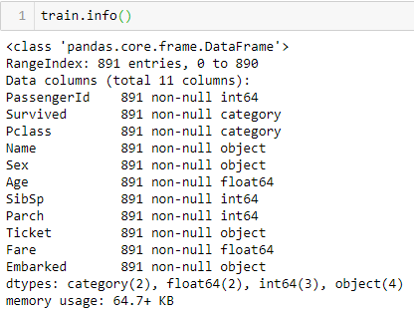
Remove columns
There are 687 rows that miss the value for “Cabin”, it might not be a best way to fill the NaNs with mode, and in this case, we can simply remove the whole column of ‘Cabin’
Use .drop() to delete columns
Use .info() to check again the information about the train dataset
train = train.drop(columns='Cabin')

Slide 10
Data Visualization
Visual representation of data
To communicate information clearly and efficiently
Effective visualization helps users analyze and reason about data and evidence
Type
Box plot
Scatter plot
Histogram / Bar chart
Import related libraries for Data Visualization
import seaborn as sns
import matplotlib.pyplot as plt
%matplotlib inline
fig = plt.figure(figsize=(18,6))

Slide 11
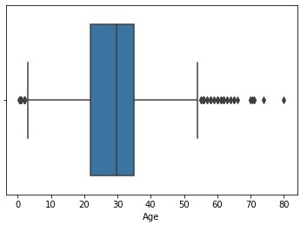
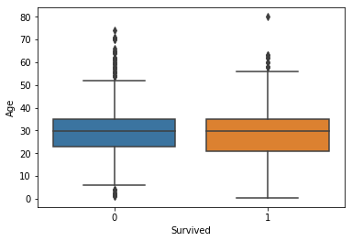
Boxplot
Boxplot for one single numeric variables
Two-dimensional boxplot, let’s see what is the distribution of ‘Survived’ by ‘Age’
ax = sns.boxplot(train['Age'])
bx = sns.boxplot(x = train['Survived'], y = train['Age'])

Slide 12
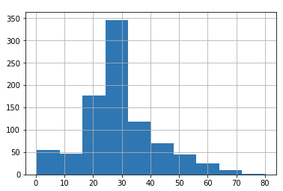
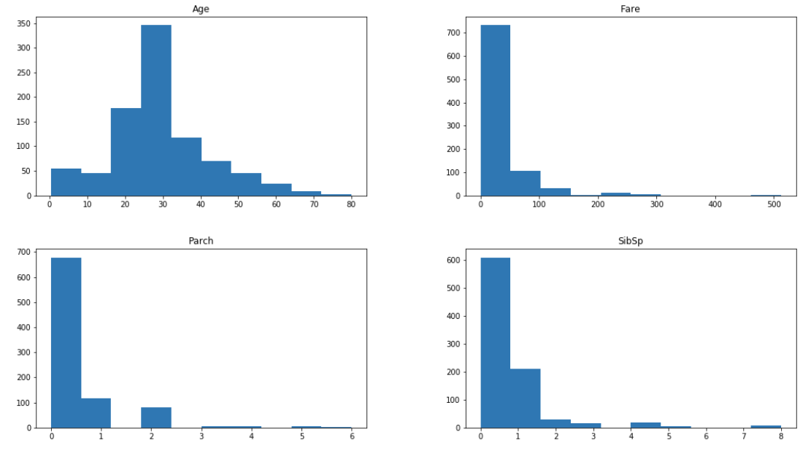
Histogram
Use .hist() to create histogram chart for numeric variables
train['Age'].hist()
train.hist(bins=10,figsize=(18,10),grid=False)

Slide 13
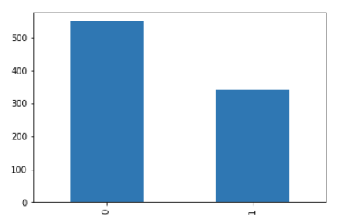
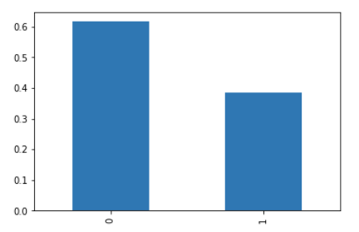
Bar Chart
Use .value_counts().plot to create bar chart for categorical variables
If you apply normalization to ‘Survived’, you can get the distribution bounded between [0,1]
train['Survived'].value_counts().plot(kind='bar')
train['Survived'].value_counts(normalize=True).plot(kind='bar')
From the chart above, around 60% of the passenger did not survived
train['Survived'].value_counts('0')

Slide 14
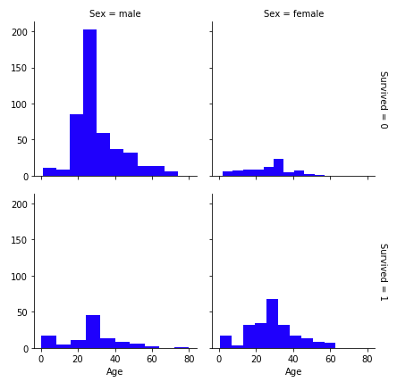
Histogram chart for categorical variables
You can create histogram with more dimensions by using matplotlib.pyplot Library
g = sns.FacetGrid(train, col='Sex', row='Survived', margin_titles=True)
g.map(plt.hist,'Age',color='blue')

Slide 15
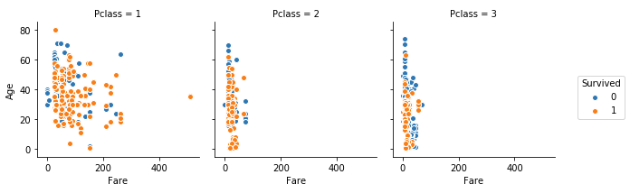
Scatter plot
Create scatter plot with more dimensions
g = sns.FacetGrid(train, hue='Survived', col='Pclass', margin_titles=True)
g=g.map(plt.scatter, 'Fare', 'Age',edgecolor='w').add_legend()

Slide 16
Feature Engineering
The process of using domain knowledge of the data to create features that make machine learning algorithms work
Considered essential in applied machine learning / data analytics
Difficult and expensive

Slide 17
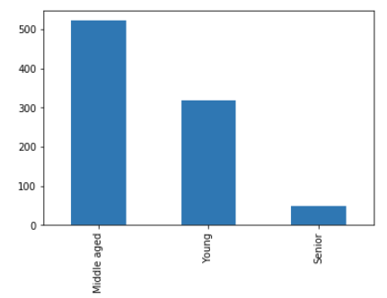
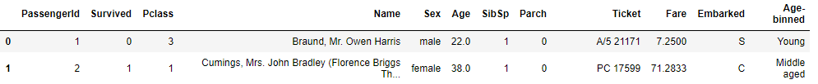
Binning / Discretization of numeric variable
Let’s apply binning to ‘Age’
How many Age group we should have? Domain knowledge
In this example, simply create 3 age groups with equal interval
Visualize the newly created variable ‘Age-binned’
Check train dataset and there is a new column called ‘Age-binned’
group_names = ['Young', 'Middle aged', 'Senior']
train['Age-binned']=pd.cut(train['Age'], 3 , labels=group_names)
train['Age-binned'].value_counts().plot(kind='bar')

Slide 18
Normalization of numeric variables
Let’s try to normalize ‘Fare’
We will need some functions from preprocessing from the sklearn library
Apply min-max normalization on a single attribute
Apply Zscore normalization on a single attribute
from sklearn import preprocessing
minmax_scaler = preprocessing.MinMaxScaler().fit(train[['Fare']])
train['Fare_minmax']=minmax_scaler.transform(train[['Fare']])
zscore_scaler = preprocessing.StandardScaler().fit(train[['Fare']])
train['Fare_zscore']=zscore_scaler.transform(train[['Fare']])

Slide 19
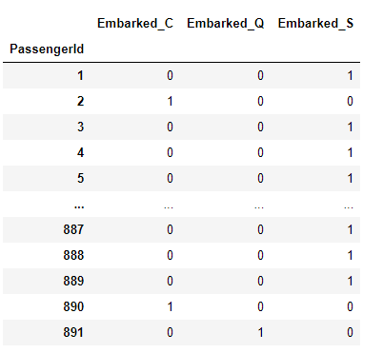
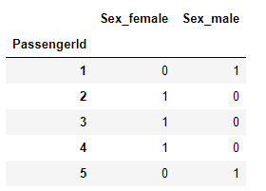
Create dummy variables / one-hot-encoding
We can use pd.get_dummies to create dummy variables for categorical features
Adding the dummy variables to the data frame
sexdummy =pd.get_dummies(train['Sex‘]，prefix='Sex‘)
trainwithdummy = pd.concat([train,sexdummy,embarkeddummy],axis=1,sort=True)

Slide 20
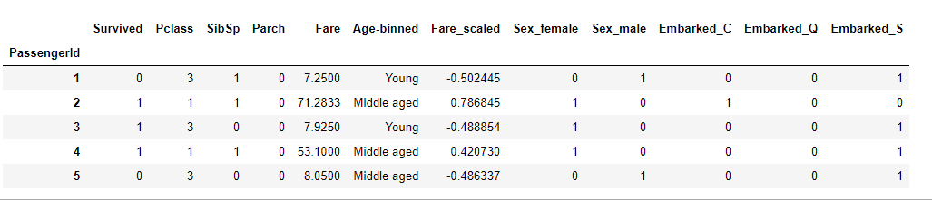
Drop features
Drop meaningless features, eg:Ticket, Name
Drop duplicated features, eg: Sex, Embarked, Age
Is the above dataset ready to use?
traindrop = trainwithdummy.drop(columns=['Name','Sex','Ticket','Embarked','Age'])

